Slide 1
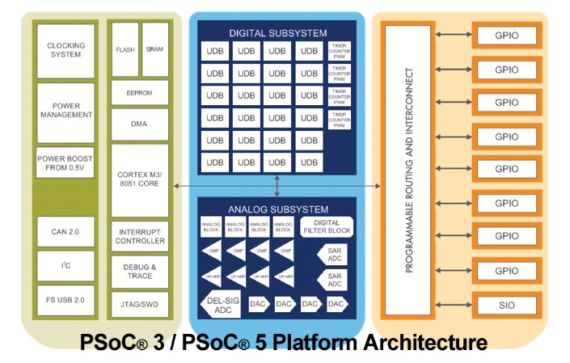
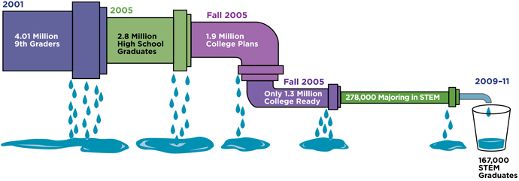
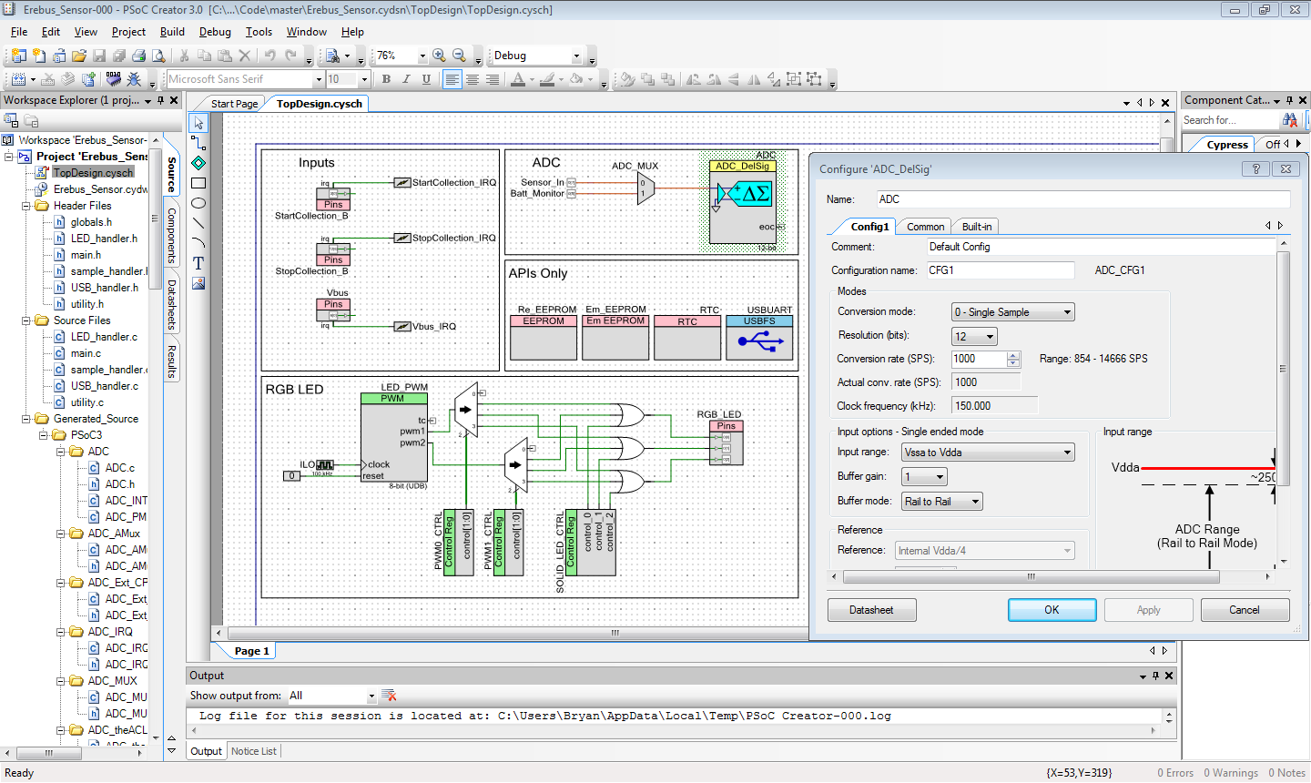

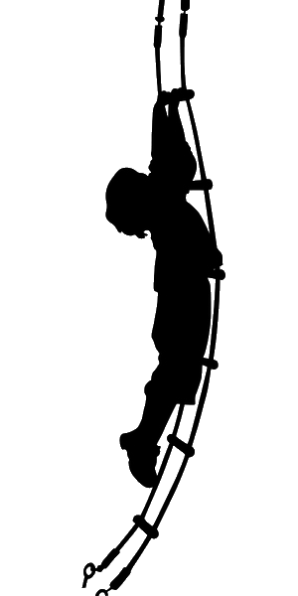
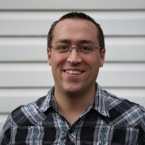
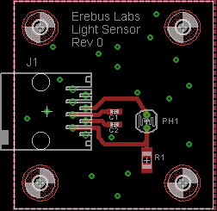
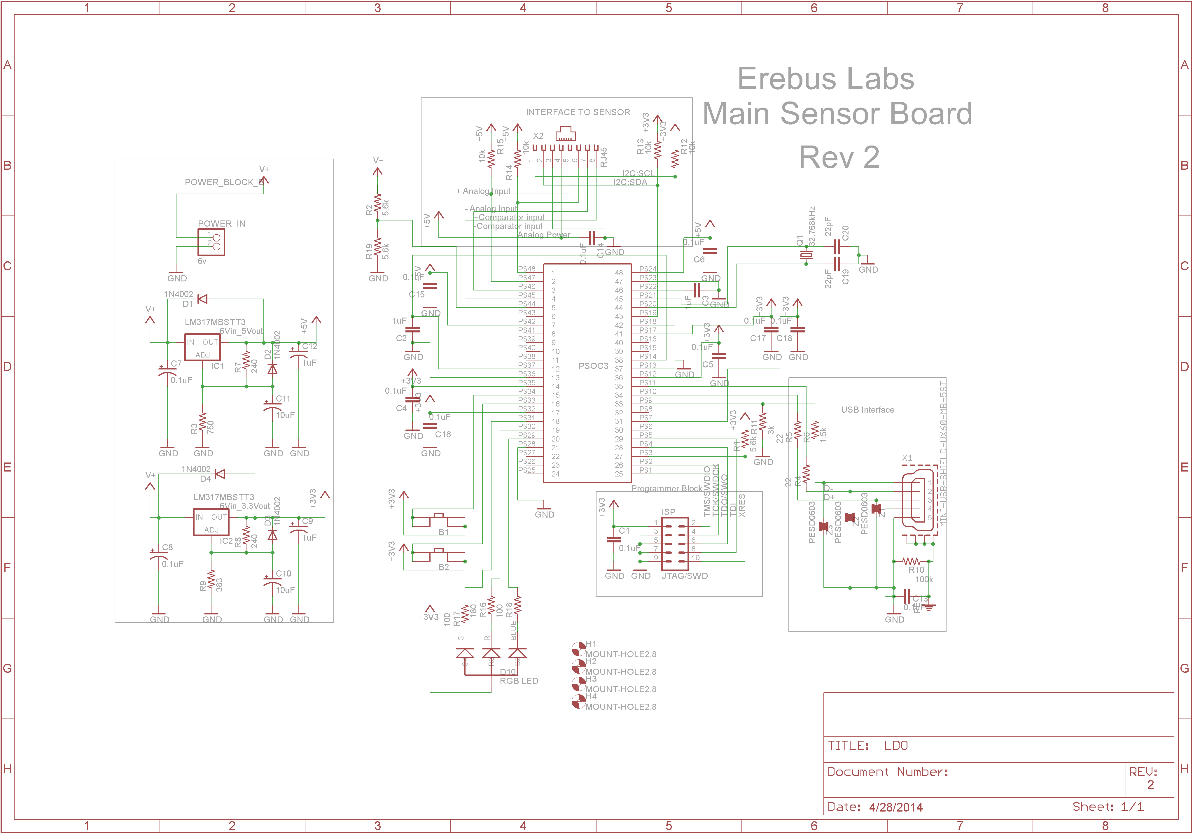

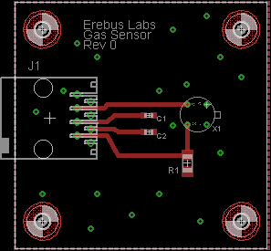

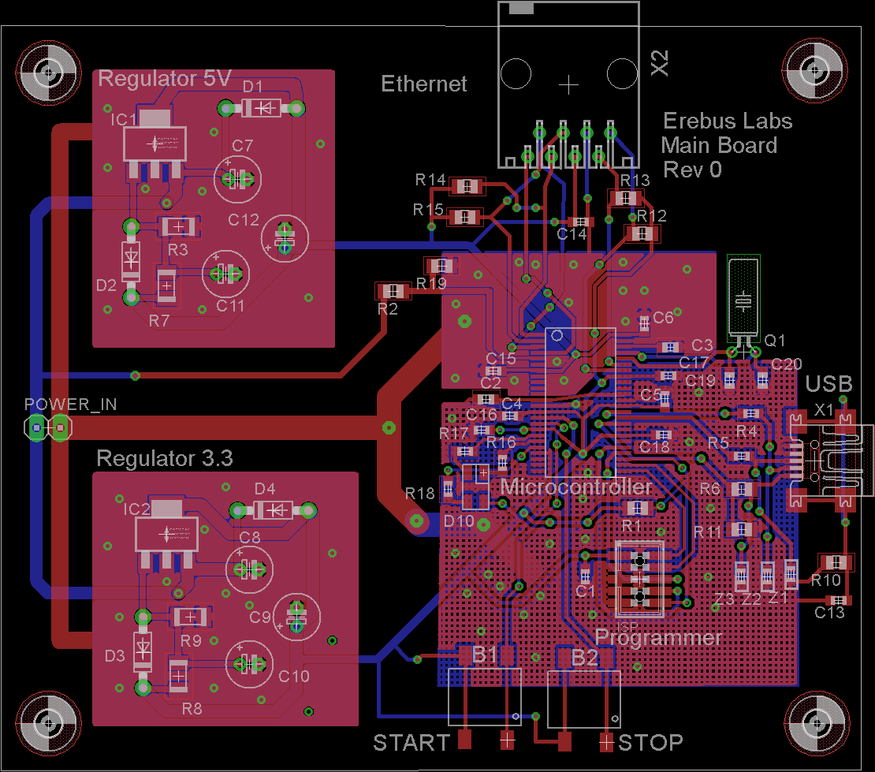
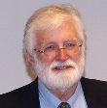


Erebus Labs STEM Sensor
Overview
Implementation
Current educational curriculum in the US lacks a focus on Science, Technology, Engineering, and Mathematics (commonly referred to as STEM). Lack of interest begins in elementary classrooms where 50% of 8th graders have a hostile attitude towards math and science¹. Furthermore, according to the United States department of education, only %16 of American high school seniors are proficient in mathematics and interested in a STEM career².
For the processor, we chose to use the Cypress PSoC 3 system on a chip. We chose this due to its low cost, feature set, and flexibility. The PSoC 3 architecture allows most pins to be used for any application (such as a GPIO or an ADC). It also has built in SRAM and EEPROM which helped us avoid the need for additional chips.
The STEM pipeline problem^{4,5}
Objective
Our goal was to create a device that would allow students, or anyone who is interested, to easily measure the world around them. Getting kids interested in the ideas behind science and engineering is the first step towards getting them interested in a STEM career later. We wanted to make the learning process as simple as plugging a sensor into a data collection device so students could focus on collecting data rather than programming complicated modules.
The PSoC Creator software which is used to program the PSoC 3 hosts API and block diagram based programming. While quite a bit of code still needed to be written by hand, the well documented APIs included in the software facilitated the rapid design of our prototype.
“50% of 8th graders have a hostile attitude towards math & science”
PSoC Creator Software
The Team
Our board design was done using the free version of CadSoft’s Eagle PCB layout software. Additionally, the PSoC Creator software is free to download with no limits. This way schools or individuals who wish to work with our files are free to do so without the restriction of cost.
Scott Lawson
Computer Engineering
Maxwell Cope
Electrical Engineering
Final Result
Bryan Button
Electrical Engineering
Chris Clary
Electrical Engineering
Our final implementation consists of two parts; a base station and an individual sensor module. This modular approach allows for more flexibility in the future. For the initial build we chose to include light and gas sensor modules.
Light Sensor
References
Mike Borowczak, Ph.D. - Sponsor
Data Analytics Engineer @ SolidFire
Founder @ ErebusLabs
GUI Pic Goes Here
Using a GUI developed by our team, users are able to configure sample rate, download data, and view any errors present in the system.
www.becpdx.org/nem/stemconnect.aspx
www.ed.gov/stem
http://nationsreportcard.gov/reading_math_2013
Image courtesy of http://www.businessandeducation.org/supporting-stem-pipeline
Data source: NCES Digest of Education Statistics; Science & Engineering Indicators 2008
Gas Sensor
Andrea Burrows - Sponsor
Assistant Professor of Secondary Education
University of Wyoming
Base Station Schematic
The base station itself is simple to operate. It has a single RGB LED to indicate system state, and a two button system that starts/stops sampling
James E. Morris - Advisor
Professor of Electrical and Computer Engineering
Portland State University
Base Station Board
Department of Electrical and Computer Engineering

